Slide 1
Water demand impacts during the extreme summer of 2018
Twenty65 Conference 2019
A water sector collaborative study
Mumin Islam Affinity Water
Sarah Rogerson Artesia
Dene Marshallsay Artesia

Slide 2
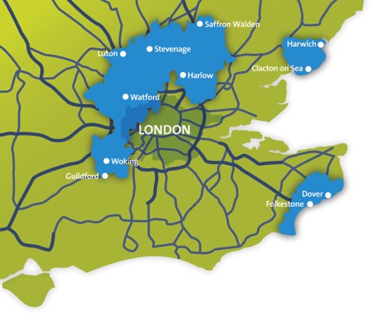
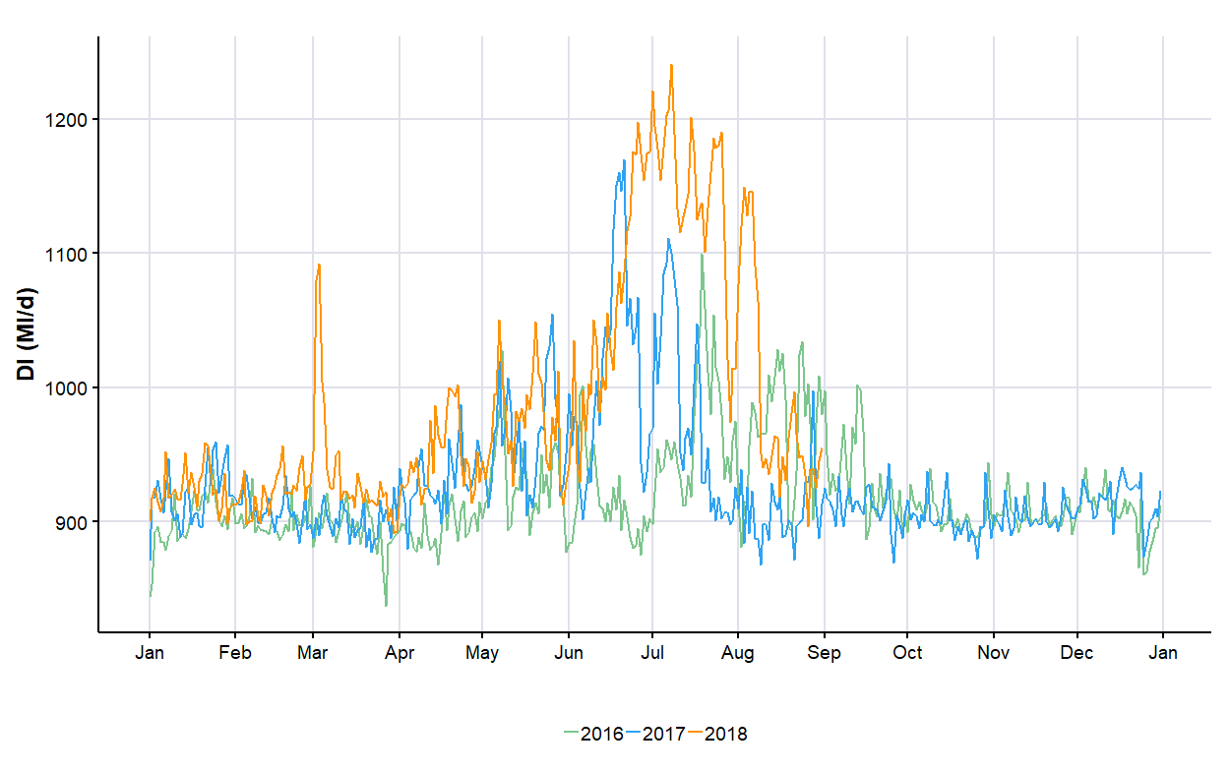
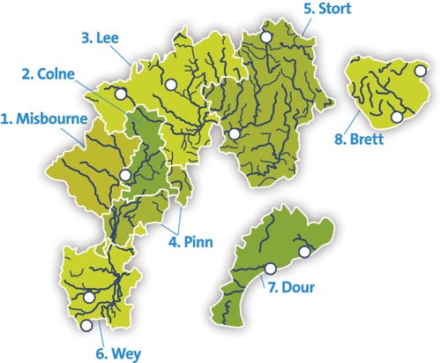
Affinity Water experienced a significant increase in demand in 2018
Affinity Water’s supply area typically supplies around 900 Ml/d to about 3.6 million customers
The region’s supply is predominately groundwater (about 60/40 groundwater to surface water
Distribution input (DI) shows a significantly higher and longer peak in 2018 than in previous years (2018 is shown in orange on the graph below)

Slide 3
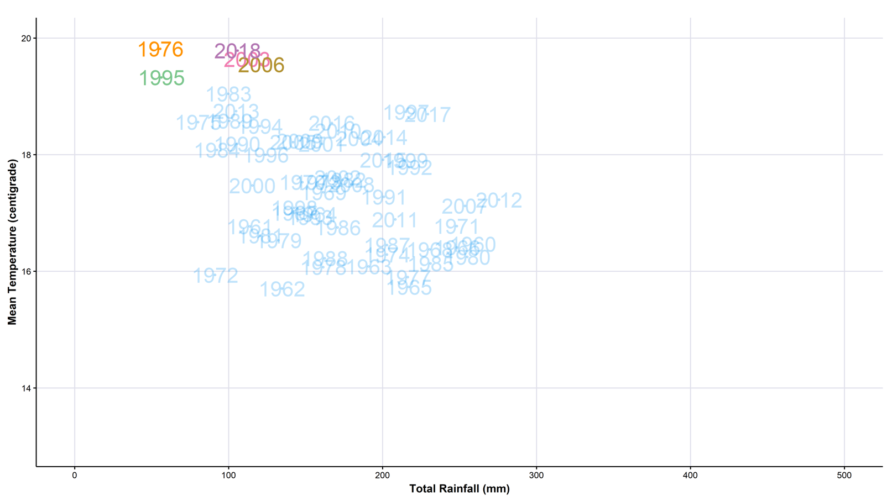
2018 weather was as extreme as previous drought years
This graph shows the mean temperature (y axis) and total rainfall (x axis) for June, July and August in the south east region for all years from 1960.
The peak or drought years of 1976, 1995, 2003 and 2006 are all in the upper left quadrant.
2018 was as hot as 1976, with slightly more rainfall.
Note the position of 2006.

Slide 4
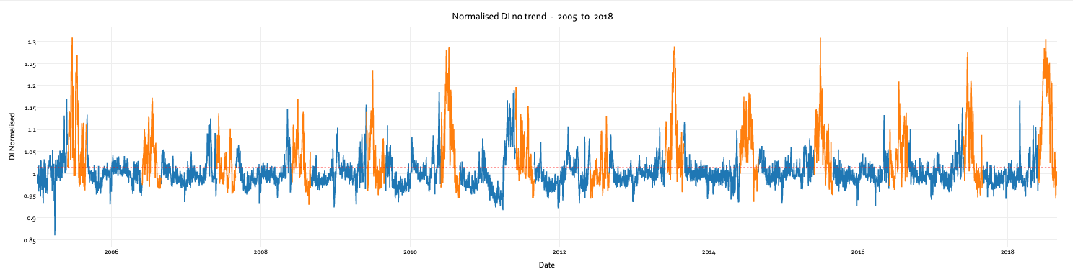
The sustained peak in 2018 was the most significant for 13 years
“Beat the drought” campaign suppressed demand in 2006
2018 saw new records for the Affinity regions:
39 consecutive days of demand over 1000Ml/d
58 days of total rainfall less than 0.5mm!

Slide 5
2018 lessons for Affinity water
Key impacts and lessons
The key challenge was physically providing the volume of water demanded during that period in July-Aug 2018.
Significant strain on resources to deliver more - Water produced at sites for that summer 2018 period was 10% higher than average and about 21% higher from our surface water treatment works.
Interesting observation was the effect of metering showed little impact during peak demand period.
Operational and planning for the future
Continued operational discussion and collaboration with Water Resources in the South East group exploring ways to advance plan for dry weather and potential transfers across water company boundaries.
“Supply 2040” - a strategic programme to build better inter-connectivity throughout our Central region to remove constraints within our distribution network that will allow us to ‘unlock’ and transfer existing capacity to meet the supply/demand deficits forecasted whilst also improving operational resilience to non-drought events.
We will continue to better understand and monitor behaviour change and water saved from our universal metering programme and demand management initiatives as part of our monitoring and engagement plans.

Slide 6
A collaborative study into the 2018 peak demand
A number of water companies got together to gather data on the 2018 peak period and to:
  quantify the impact of the 2018 heatwave on water demand, and
  provide insight, data and strategies to ensure resilience against similar future events
Compiled a large database of demand data: distribution input, non-household demand, household demand and leakage
Investigate the regional differences in the 2018 peak
Provide insights into what is driving the peak demand
Consider what this means for reporting and planning
Consider how peaks could be mitigated in the future
The study will conclude during April, and report in May
This presentation provides a glimpse of some of the findings using data from a range of companies
This collaborative study is supported by the following companies and organisations:
Affinity Water,
Anglian Water,
Bristol Water,
Dŵr Cymru Welsh Water,
Environment Agency,
Natural Resources Wales
Portsmouth Water,
SES Water,
Severn Trent Water,
South East Water,
South Staffs Water (inc. Cambridge),
South West Water (inc. Bournemouth),
Southern Water,
Thames Water,
United Utilities,
Yorkshire Water,
Wessex Water.

Slide 7
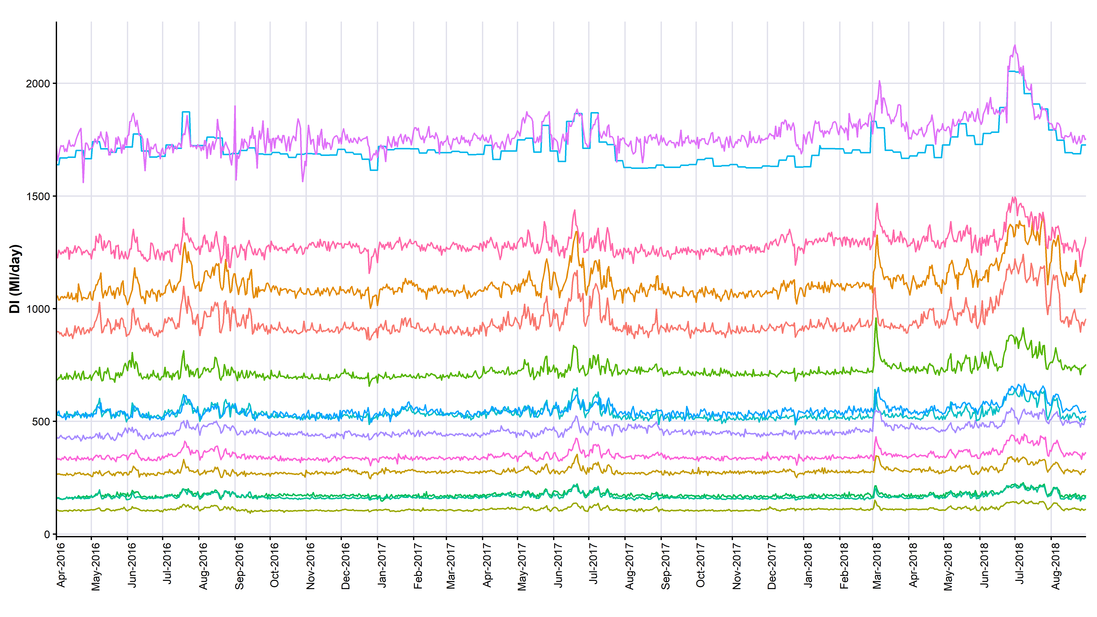
Distribution input across England & Wales show similar trends
“Beast from the East”
Peak summer 2018

Slide 8
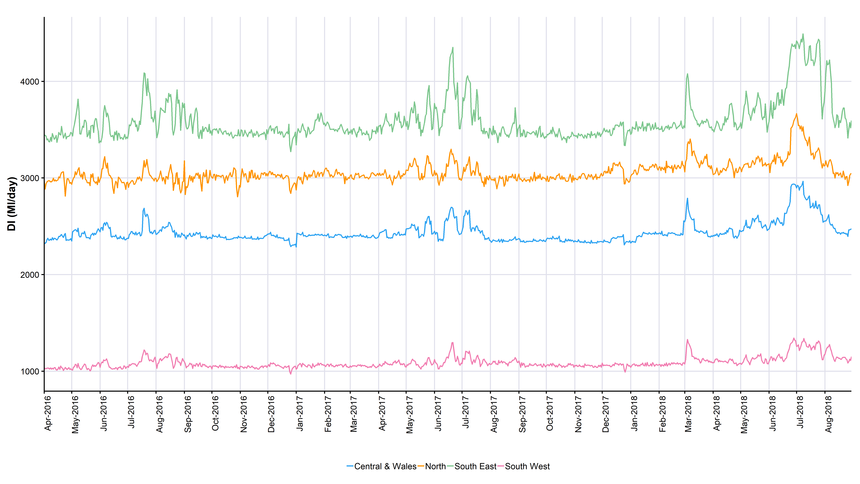
Regionally the shape of the peak in 2018 differs
For the northern (orange) and central & Wales (blue) regions, the peak demand falls away during July and August
In contrast the peaks in the south east (green) and southwest (pink) are maintained through July into August.

Slide 9
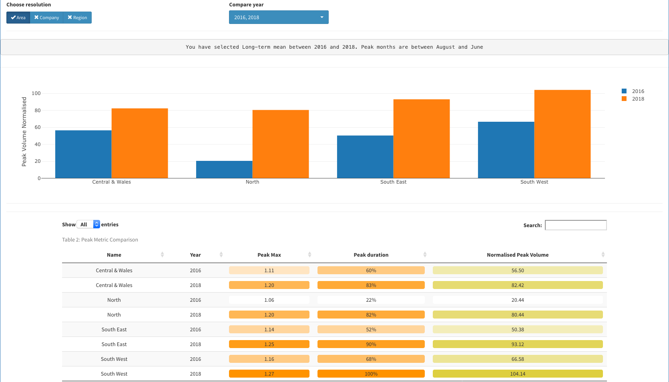
Geographical comparison of the DI normalised peak volume by area; 2016 vs. 2018
The highest normalised peak volume is the south west area, marginally greater than the south east.
However the biggest increase is seen in the northern region, with peak volume in 2018, 4 times that experienced in 2016.

Slide 10
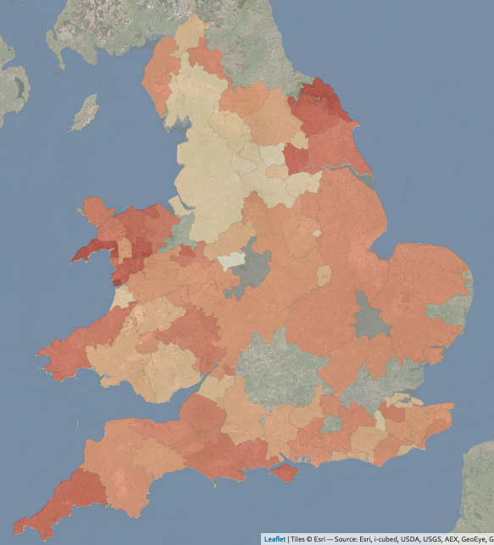
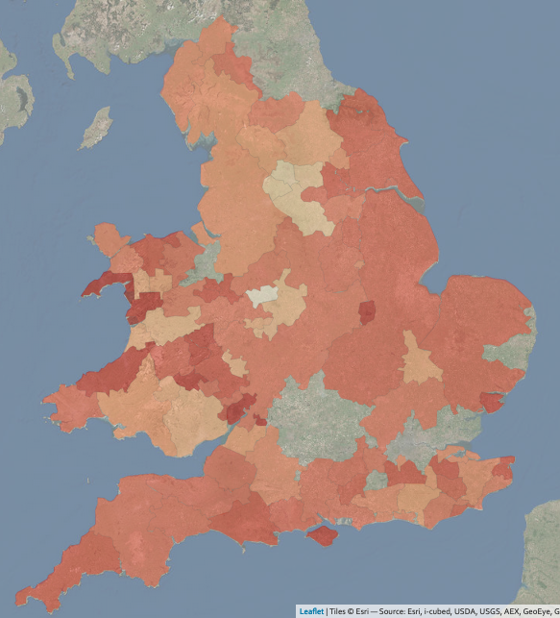
Sub company regions coloured by normalised peak summer volume 2016 to 2018
2016
2018
The graphic on the right shows much darker regions across the country, due to the increased peak demand on 2018 during the summer period.
However, some regions also show significant peak demands in 2016 (which was not a peak summer), typically coastal regions.
This may show that some areas peak demand are influenced as much by tourism than the weather.

Slide 11
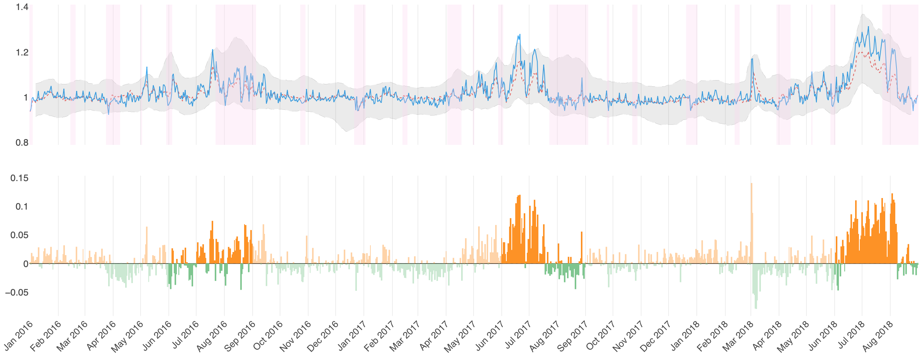
Non tourist area in the south east
Top graph shows the normalized peak volume, with holiday periods in pink, red dotted line is E&W average.
Peak demand is not greatly influenced by school holiday periods
Bottom graph shows the residual normalized peak demand compared to E&W average.

Slide 12
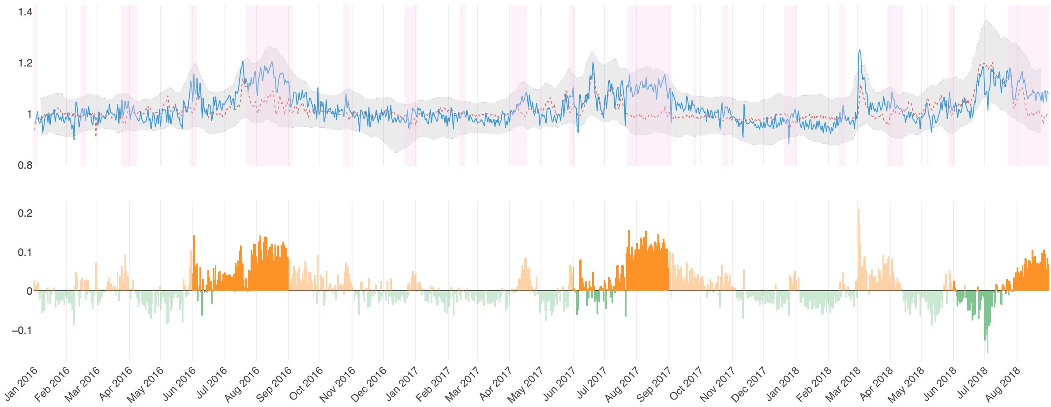
Tourist area in the south west
Top graph shows the normalized peak volume, with holiday periods in pink, red dotted line is E&W average.
Peak demand is significantly influenced by school holiday periods
Bottom graph shows the residual normalized peak demand compared to E&W average.

Slide 13
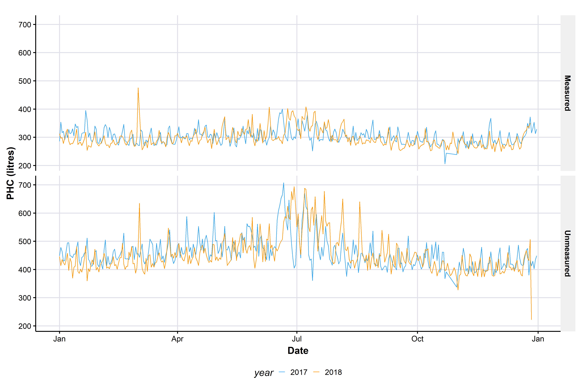
Household consumption increased in 2018
Measured households showed an increase in consumption during June, July and August.
Unmeasured households showed a larger increase over the same period, with larger increases at the weekend.
Also note the impact of the ‘Beast from the East’ on measured and unmeasured properties.

Slide 14
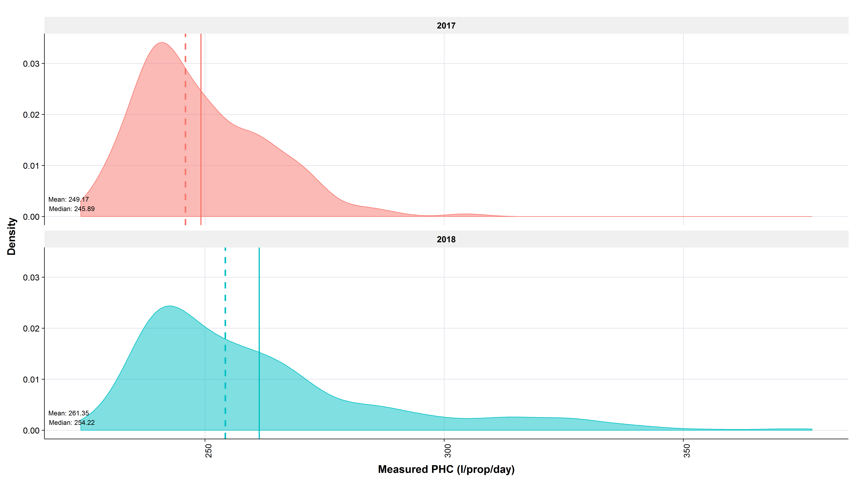
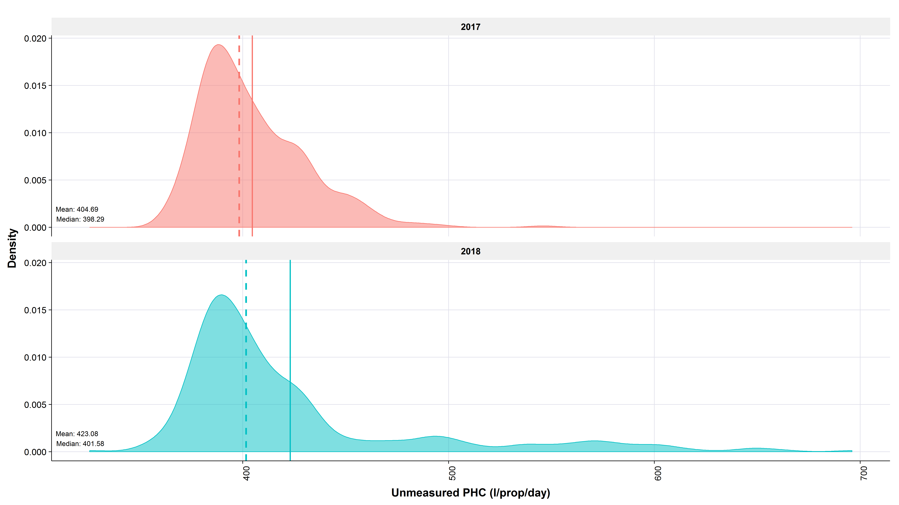
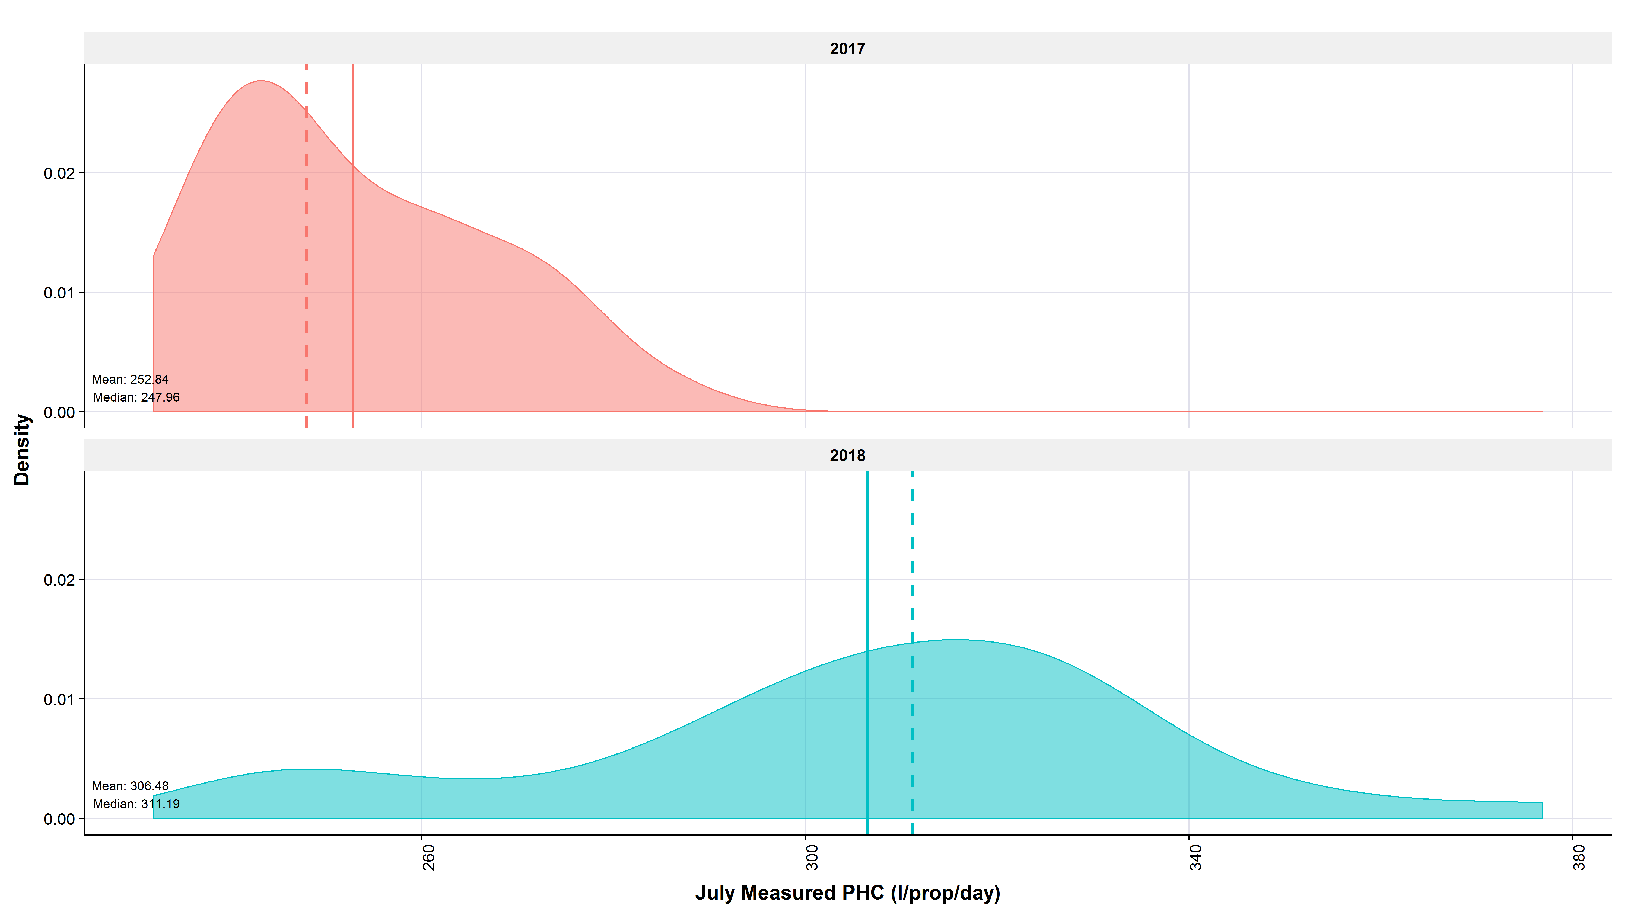
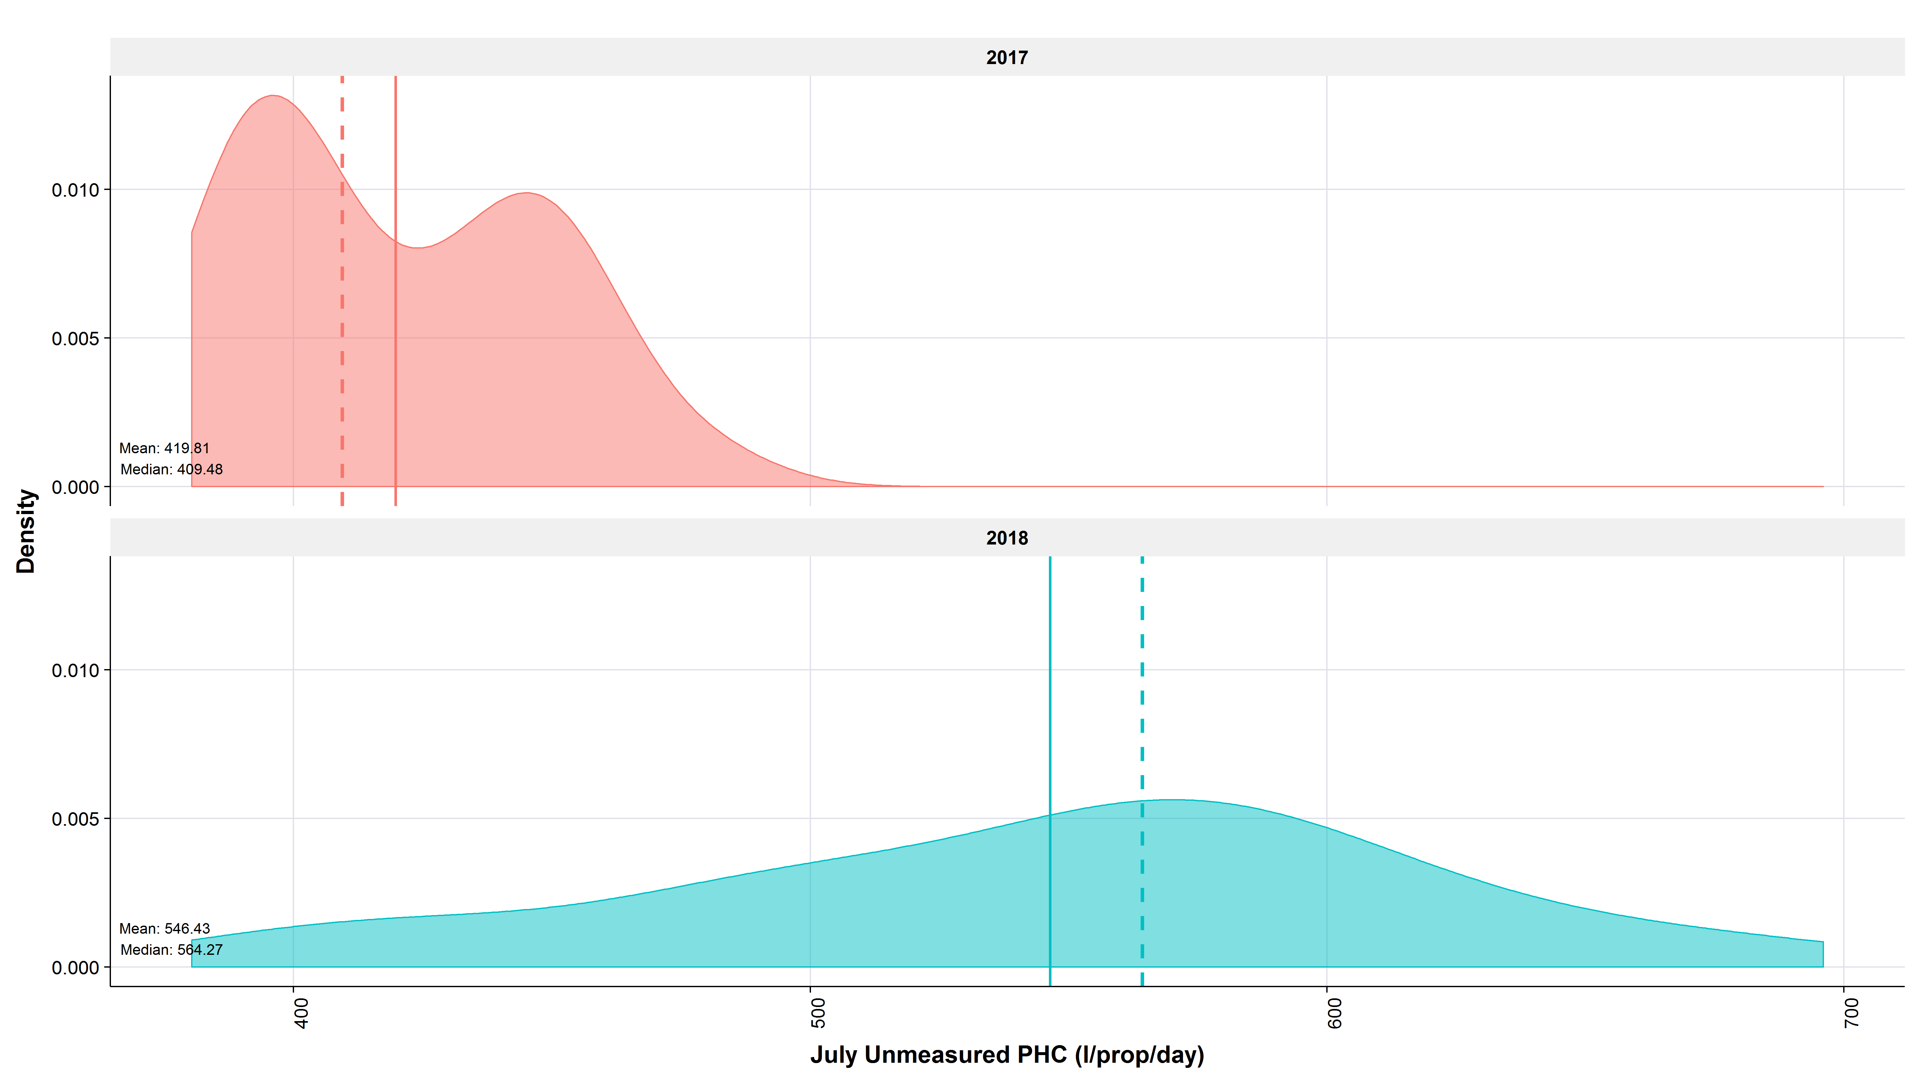
Household consumption increases in 2018 for annual average and July
Measured households
Unmeasured households
Mean = 249
Mean = 405
2017
2017
Annual average
PHC (l/prop/day)
Mean = 261
+4.8%
Mean = 423
+4.4%
2018
2018
Mean = 252
Mean = 420
2017
2017
July average
PHC (l/prop/day)
Mean = 306
+21.4%
Mean = 546
+30%
2018
2018

Slide 15
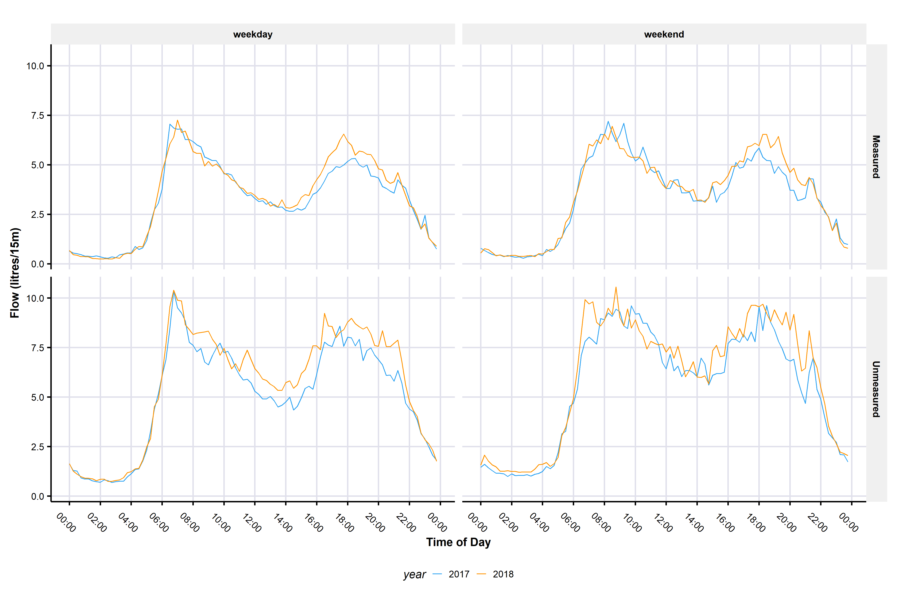
Sub-daily changes in households consumption in July
For measured households the increase in use is largely in the afternoon and evening times for both weekends and weekdays.
For unmeasured households there appears to be more consistent increase across the day for weekdays. For weekends the increase is largely in the evenings.

Slide 16
Summary
2018 saw two large peak events: the “Beast from the East” in March, and the summer demand peak.
The 2018 summer demand for most companies was the biggest peak (magnitude and duration) for 15 years.
Whilst the 2018 peak was driven largely by hot dry weather, there are regional differences, with areas seeing the peak extend right through August driven by tourism.
Household use increased in both measured and unmeasured households
Unmeasured households saw the biggest increase
Much of the increase appears to be in extended evening use during weekdays, and extended afternoon and evening use at weekends
We are continuing work on the study and hope to report in May.

Slide 17
Thank you, questions?
Contact: sarah@artesia-consulting.co.uk or dene@artesia-consulting.co.uk

